Slide 1
OPERATION & METRIC ANALYSIS
By : Muskan Bansal
Contents:
Project Description
Approach
Tech Stack Used
Insights

Slide 2
Project Description
This project is about OPERATION ANALYTICS AND INVESTIGATING
METRIC SPIKES. The project is based on ADVANCED SQL concepts.
Operation Analytics is done for end to end operations of the company to
to find the areas for improvement. It predicts the overall growth or
decline of companies fortune. Investigating for metric spikes is a
crucial part to answer various questions on daily bases for
companies functions and growth.
As Lead Data Analyst, I was provided with different Data sets,
tables from which I was supposed to derive certain insights and answer
the questions asked by different teams.

Slide 3
Tech Stack Used
LINK FOR THE DATA:
https://drive.google.com/drive/folders/1bB-uqONISA6wiI1hw1LzISpe0-kHg0Nx
MySQL Workbench

Slide 4
CASE STUDY 1
Number of jobs reviewed: Amount of jobs reviewed over time. Your task: Calculate the number of jobs reviewed per hour per day for November 2020?
Throughput: It is the no. of events happening per second. Your task: Let’s say the above metric is called throughput. Calculate 7 day rolling average of throughput? For throughput, do you prefer daily metric or 7-day rolling and why?
Percentage share of each language: Share of each language for different contents. Your task: Calculate the percentage share of each language in the last 30 days?
Duplicate rows: Rows that have the same value present in them. Your task: Let’s say you see some duplicate rows in the data. How will you display duplicates from the table?

Slide 5
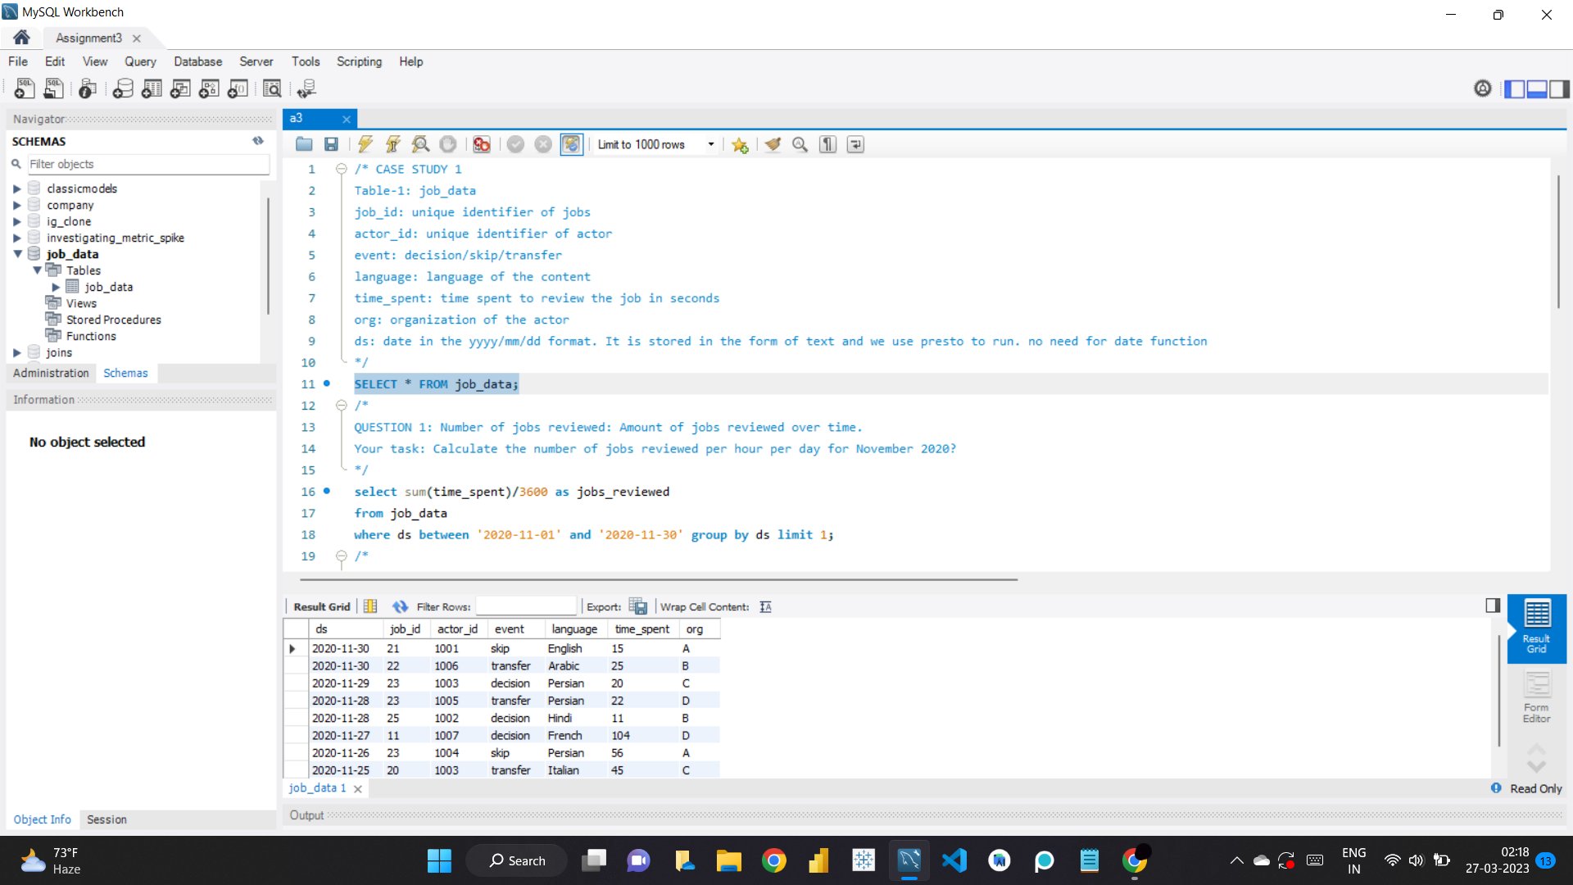

Slide 6
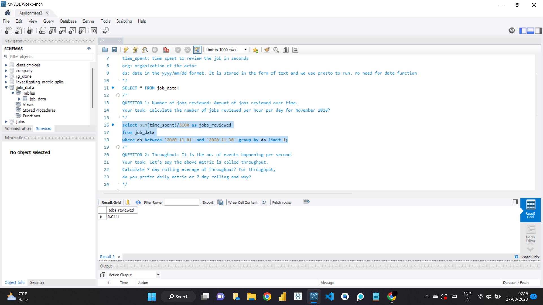

Slide 7
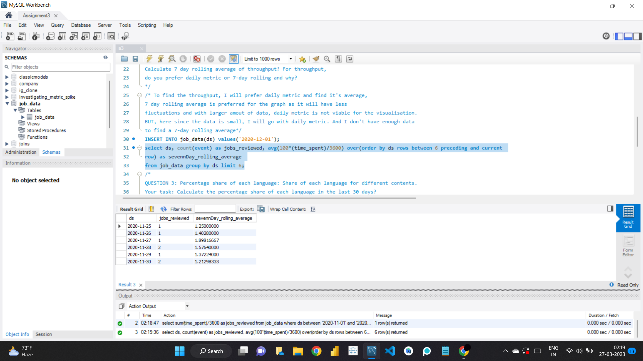

Slide 8
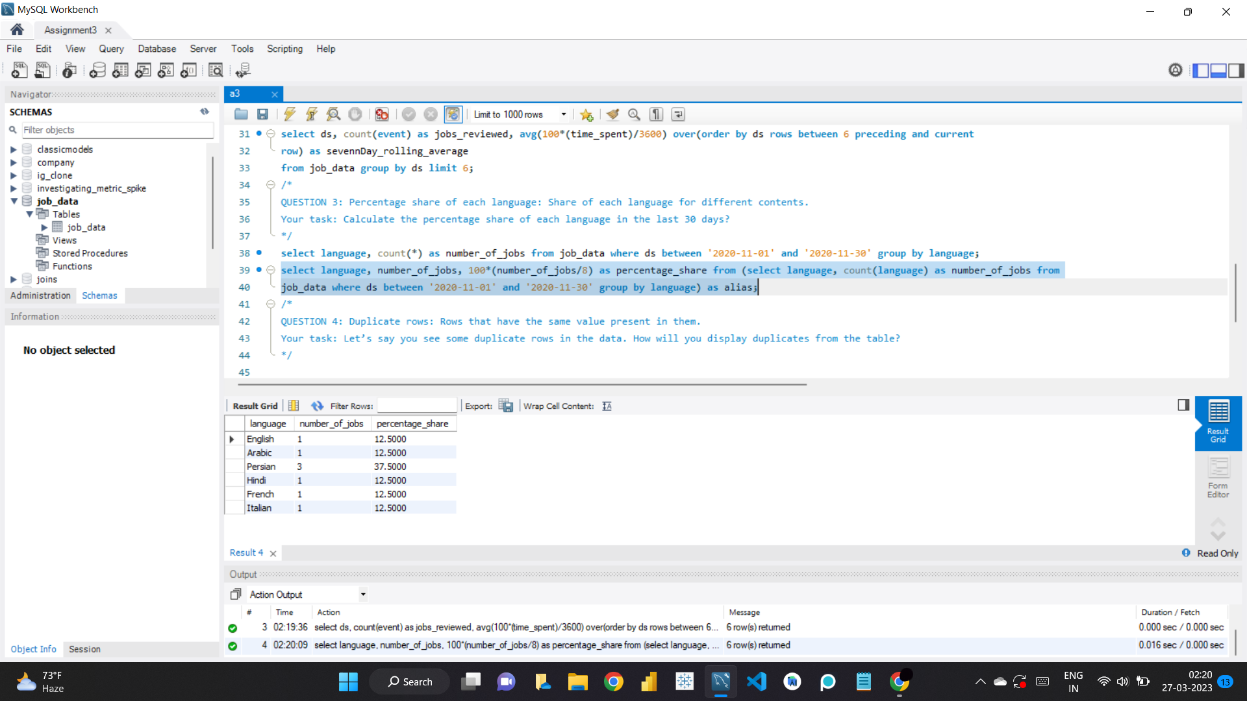

Slide 9
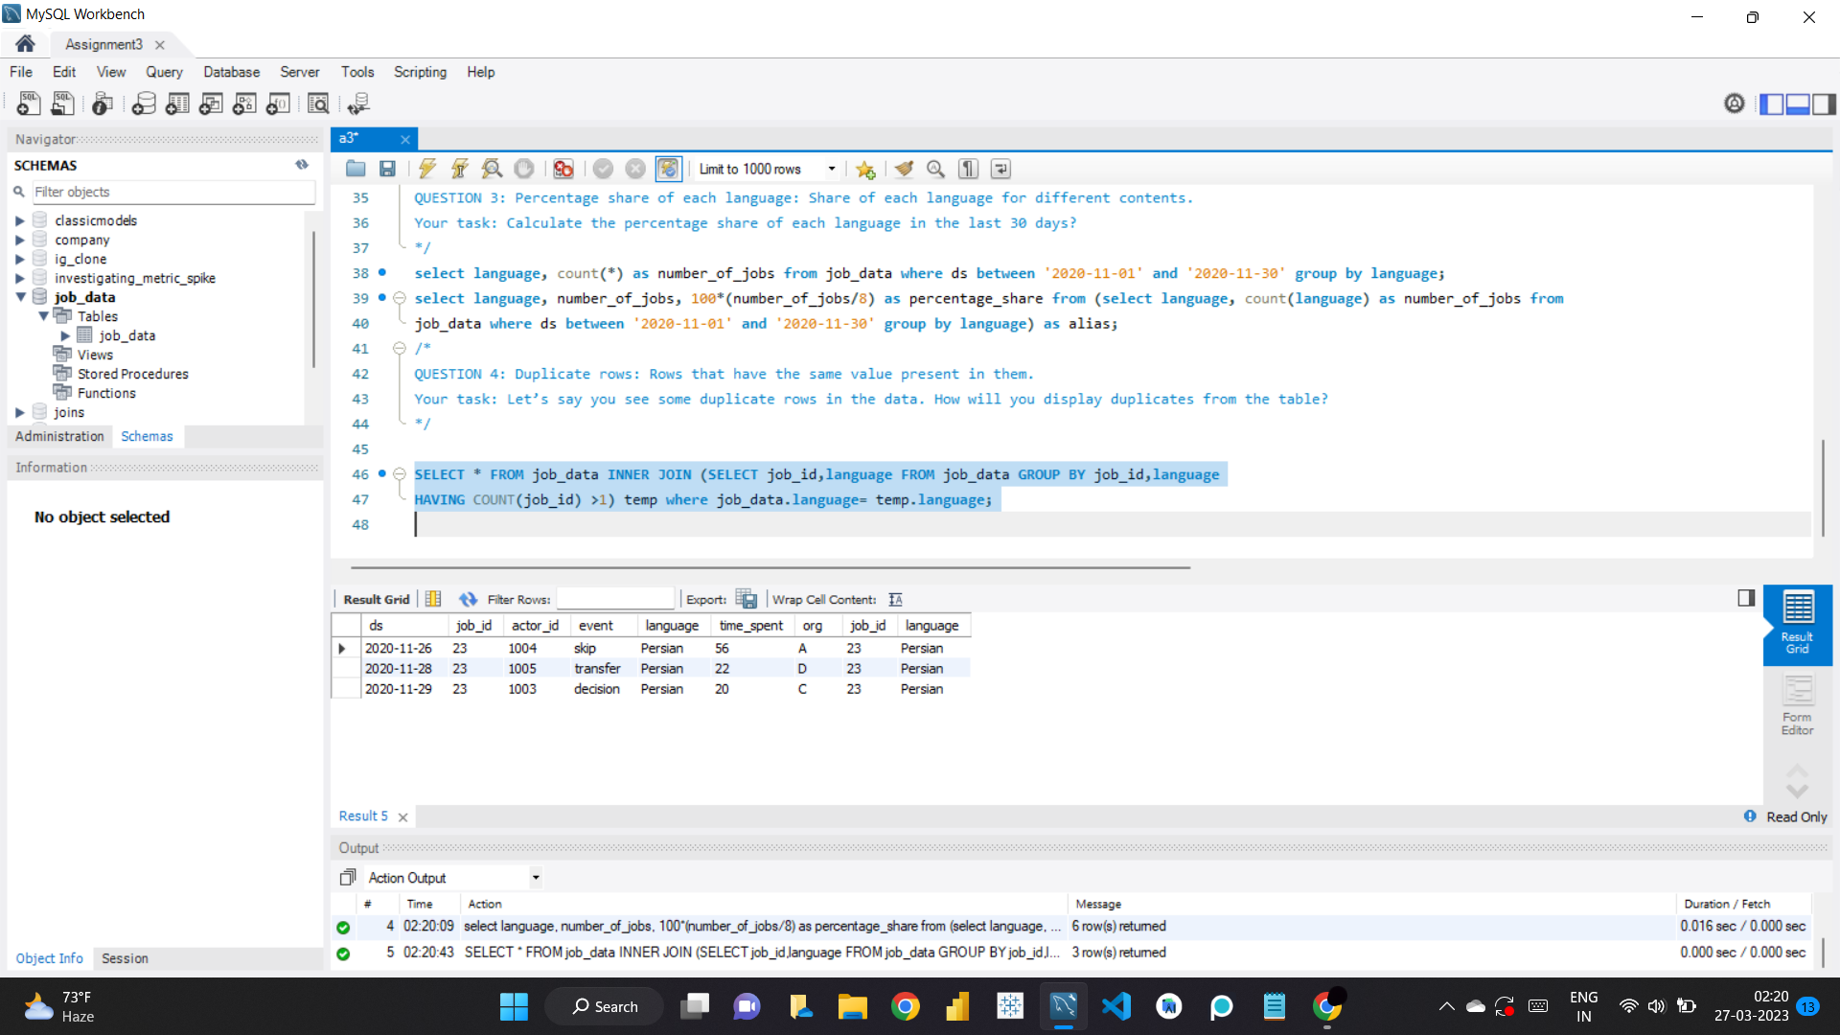

Slide 10
CASE STUDY 2
User Engagement: To measure the activeness of a user. Measuring if the user finds quality in a product/service. Your task: Calculate the weekly user engagement?
User Growth: Amount of users growing over time for a product. Your task: Calculate the user growth for product?
Weekly Retention: Users getting retained weekly after signing-up for a product. Your task: Calculate the weekly retention of users-sign up cohort?
Weekly Engagement: To measure the activeness of a user. Measuring if the user finds quality in a product/service weekly. Your task: Calculate the weekly engagement per device?
Email Engagement: Users engaging with the email service. Your task: Calculate the email engagement metrics?

Slide 11
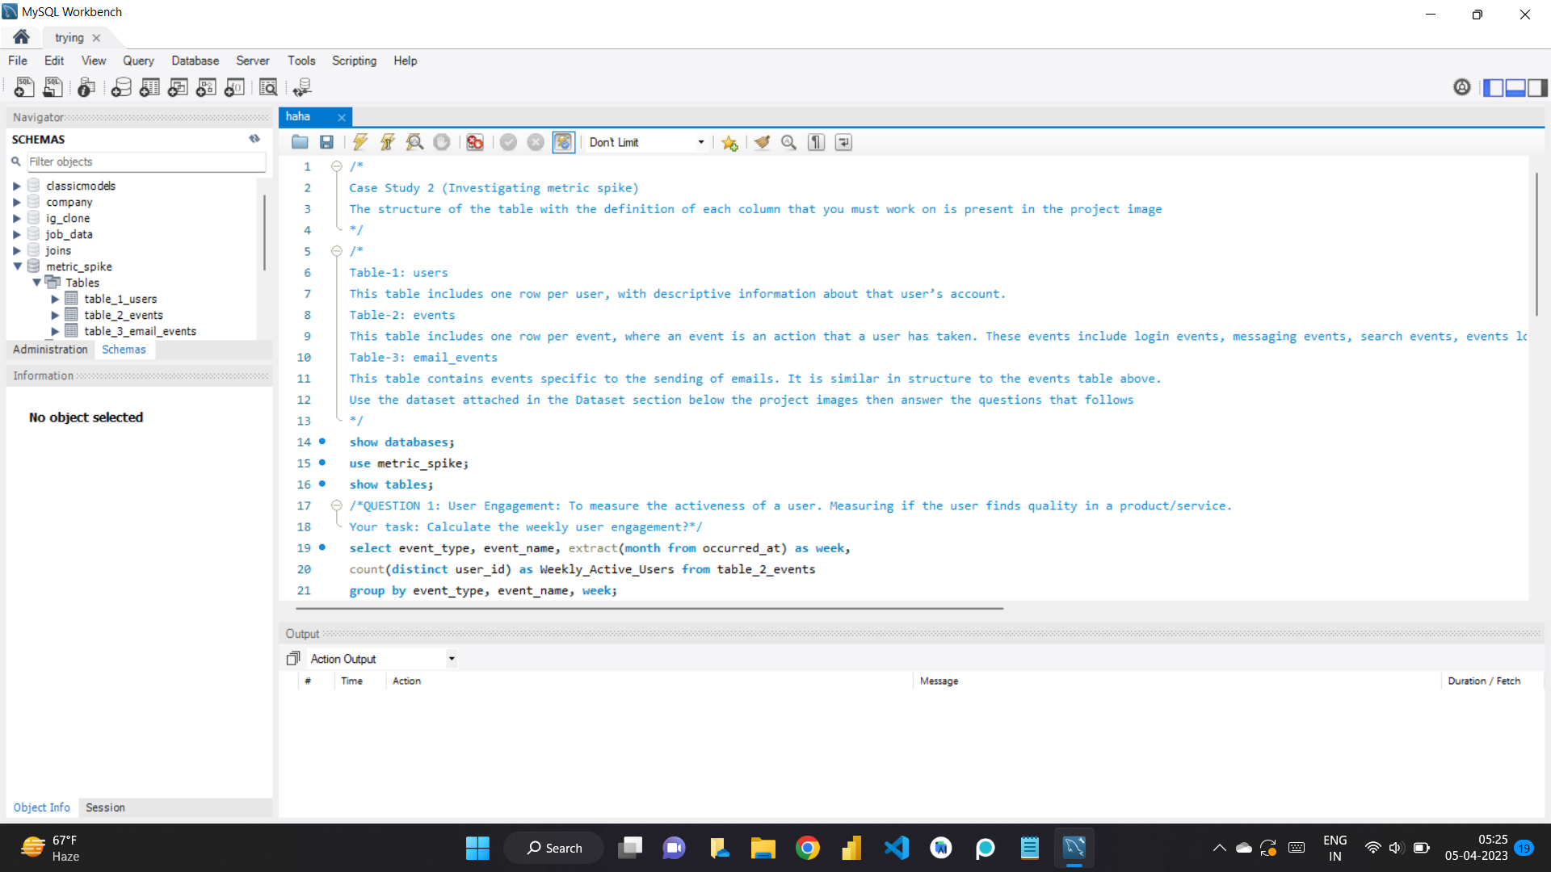

Slide 12
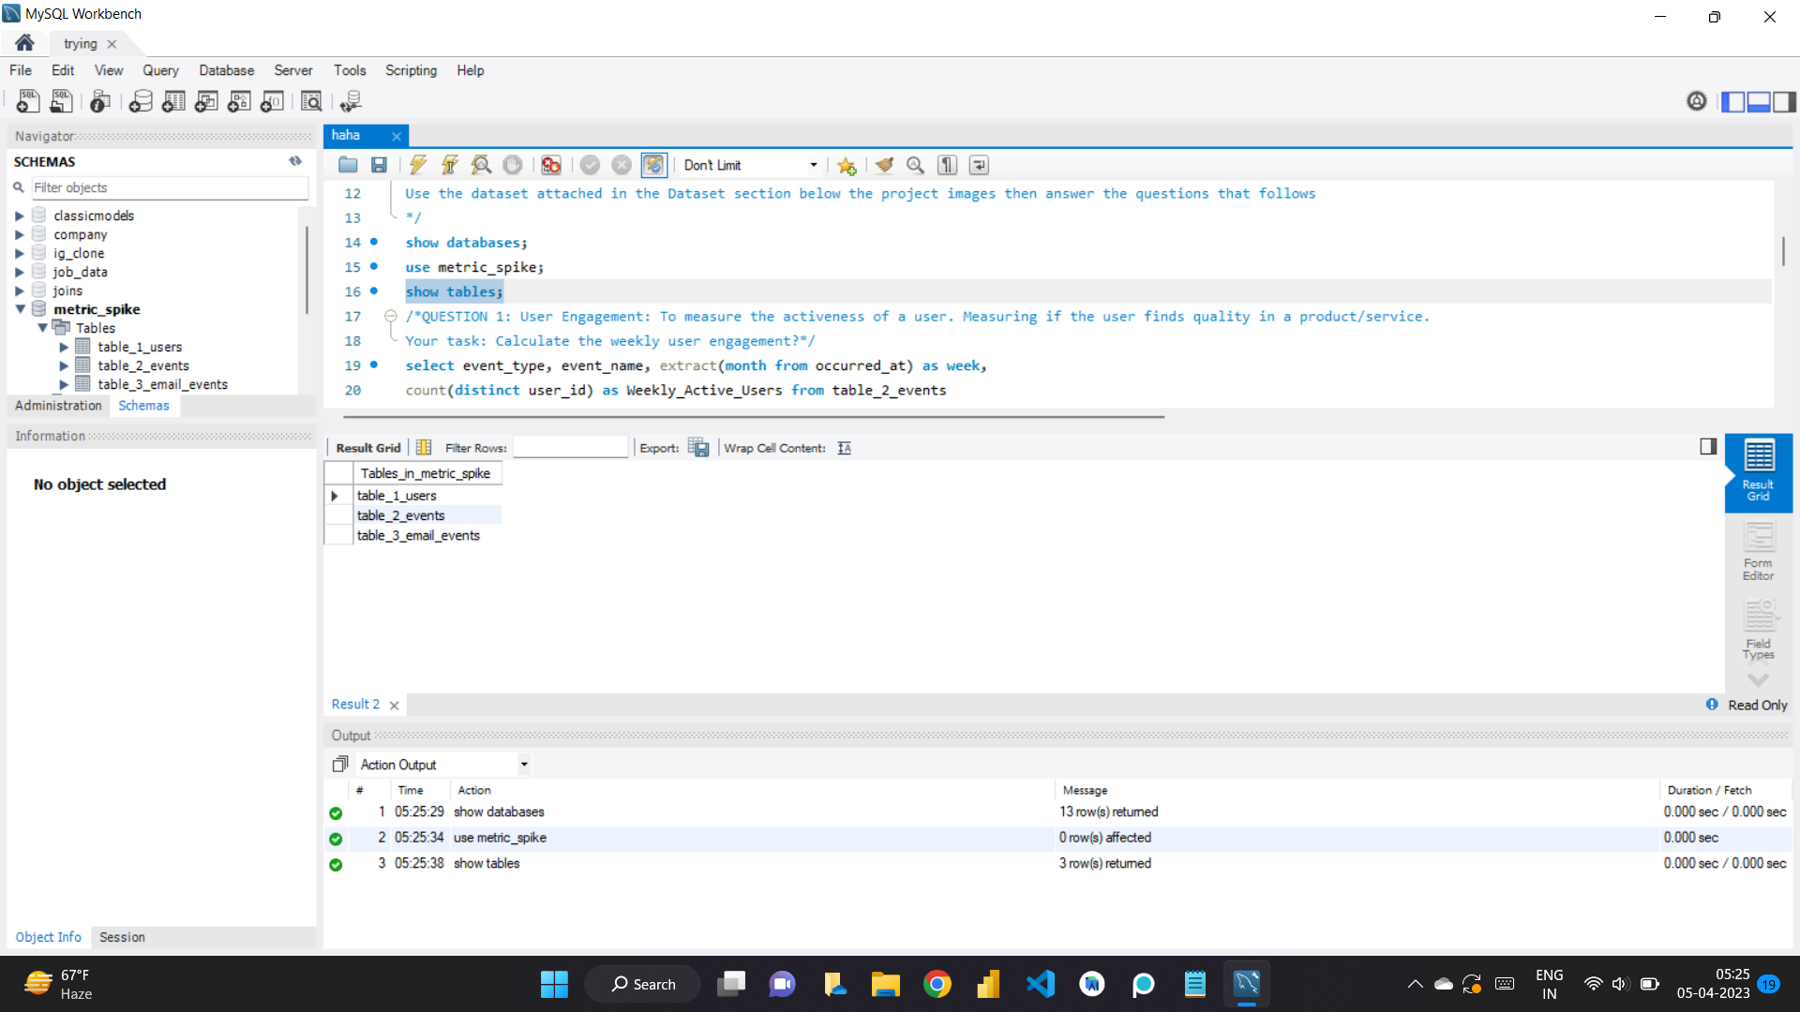

Slide 13
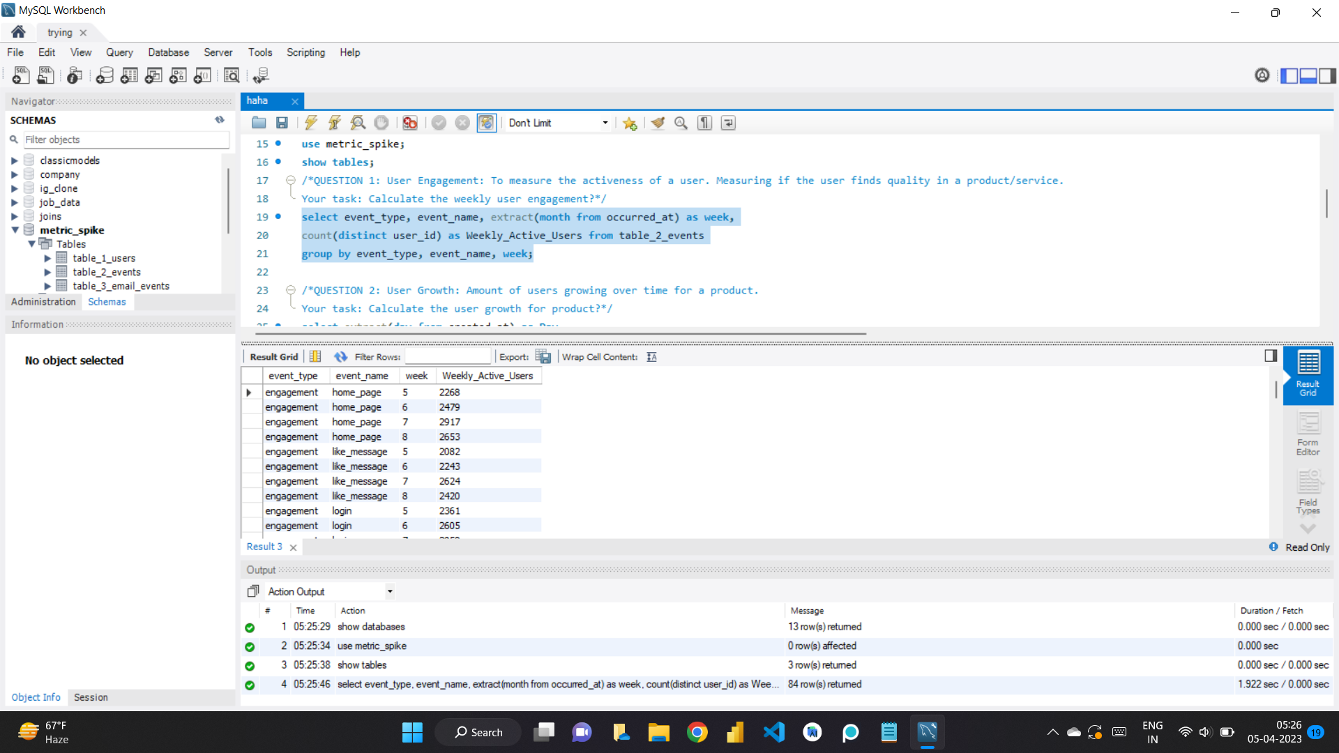

Slide 14
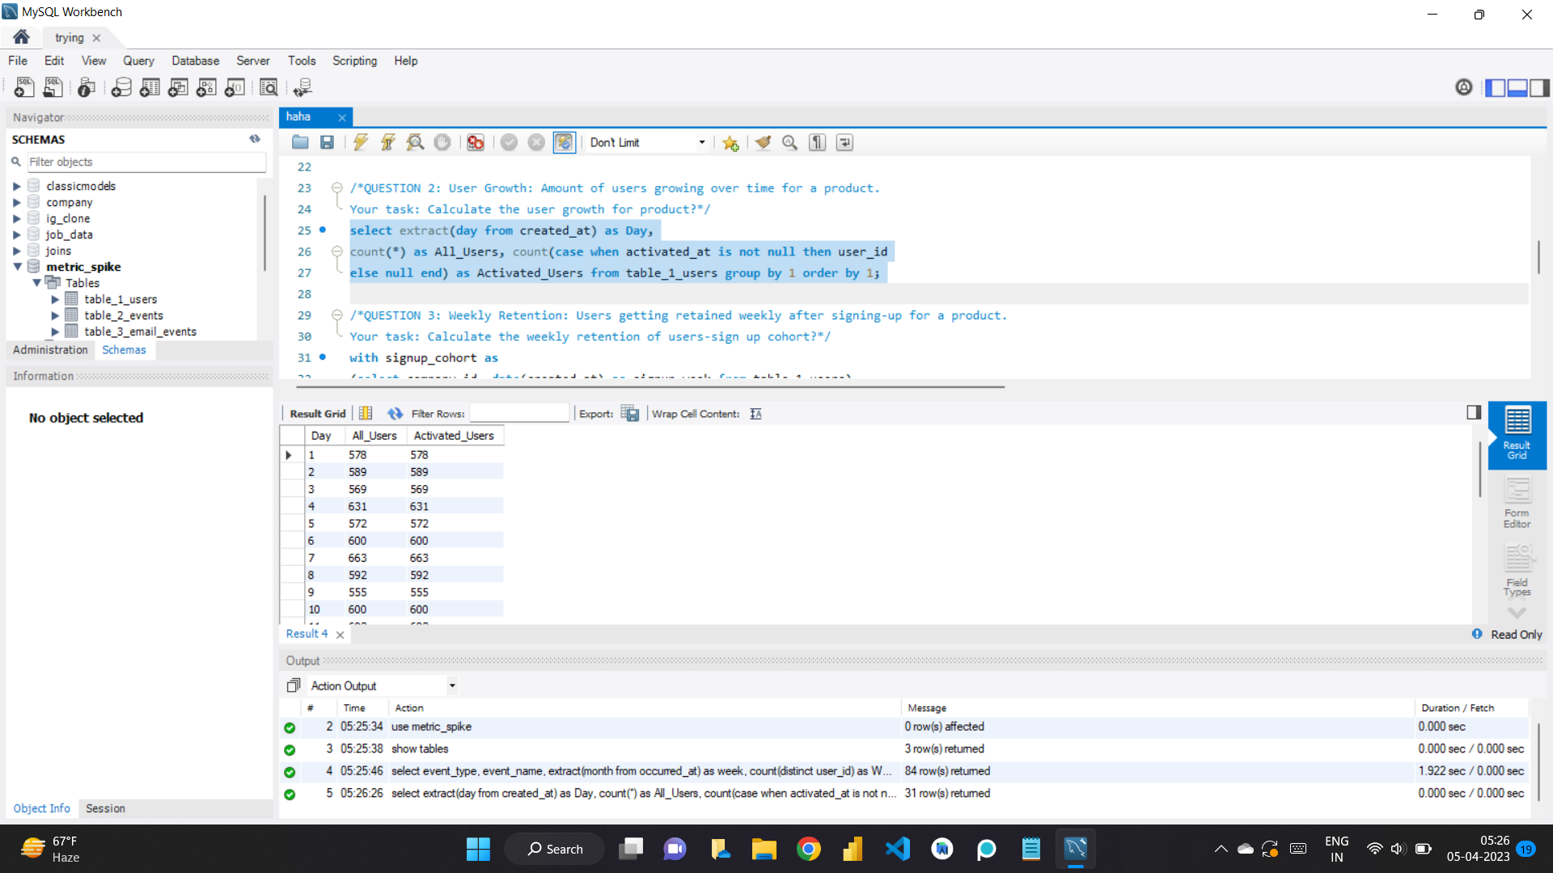

Slide 15
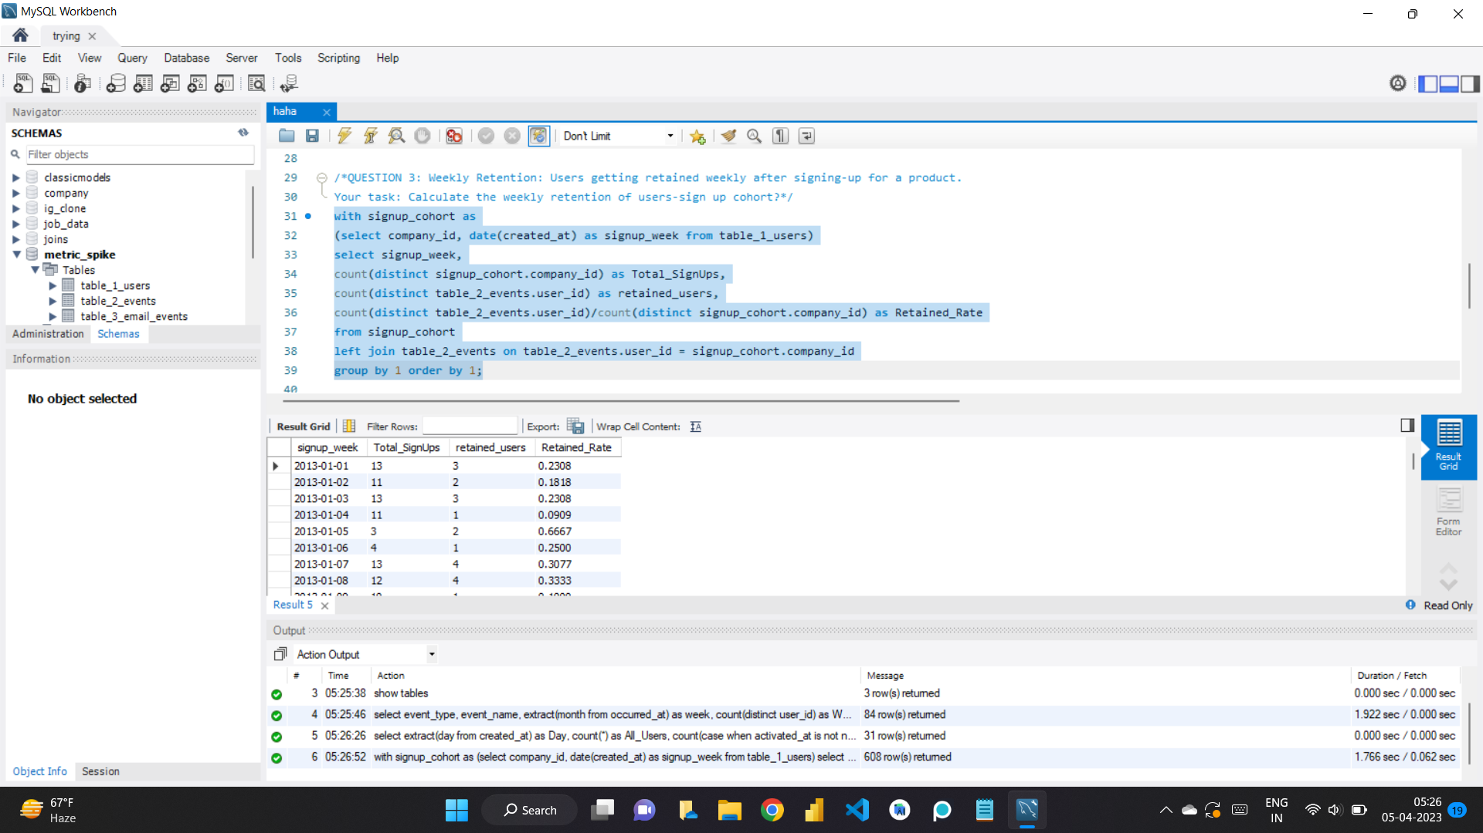

Slide 16
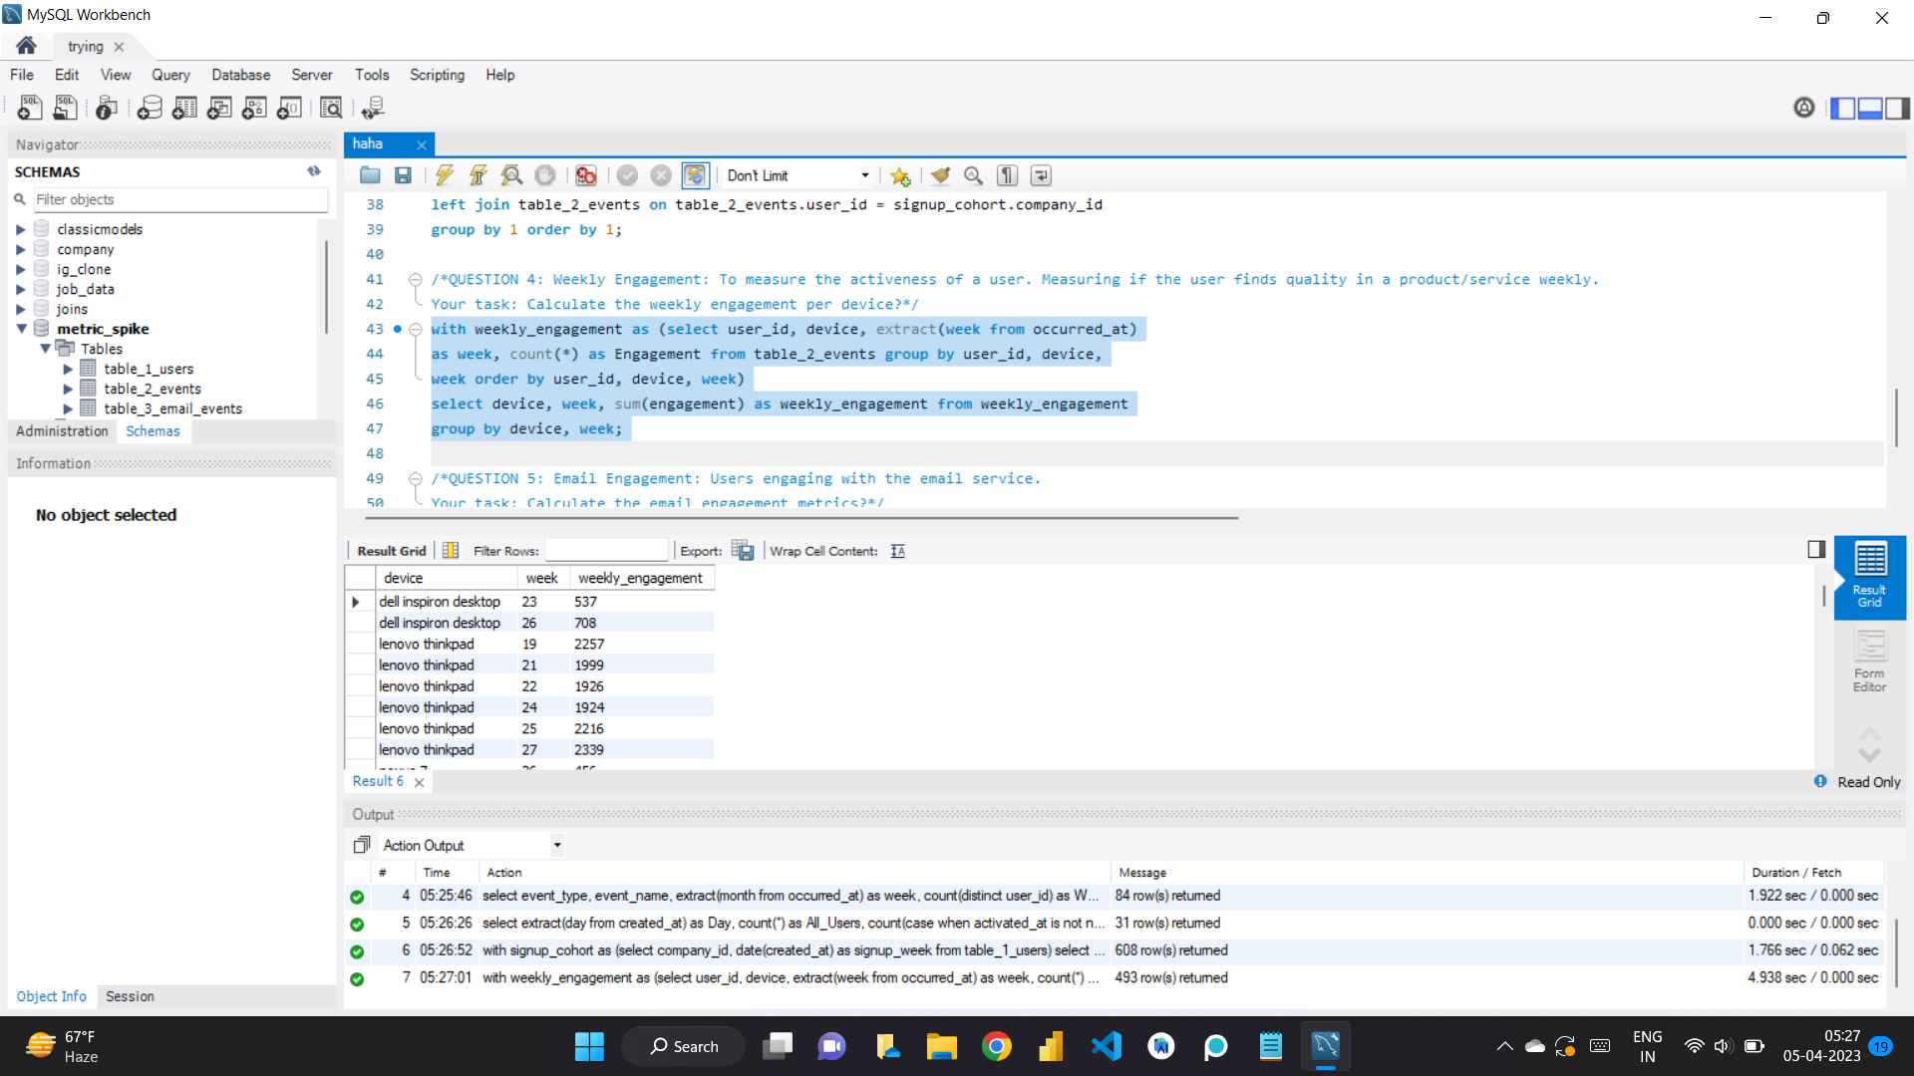

Slide 17
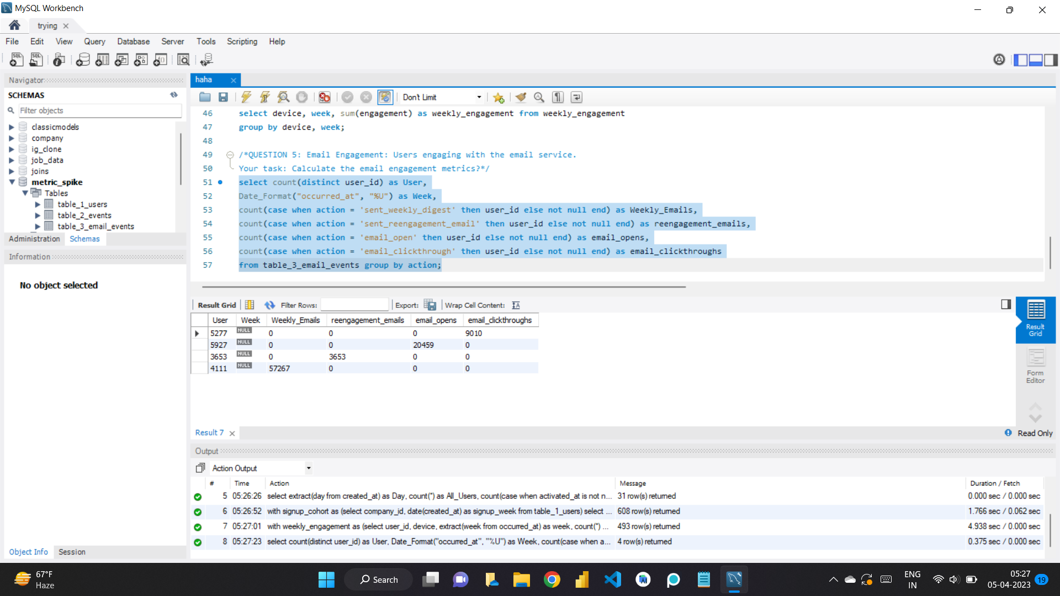

Slide 18
INSIGHTS
Firstly this project taught me new concepts as the data was too big and it caused a lot of problem while importing and due to that reasons I shifted to jupyter Notebook and Tableau and hence got to learn about few different libraries though I felt completing it in the MySQL Workbench and hence I had to flush privileges in the MySQL Command Line as it was causing few errors so basically troubleshooting.

